Slide 1
Commencement Countdown for the Class of 2022 and Returning Alumni from the Classes of 2020 & 2021

Slide 2
Welcome and Congratulations! Your Big Day is Finally Here. But first…

Slide 3
Arrival
PLEASE REMEMBER:
Plan to be here no later than 8:30 a.m. on Saturday morning.

Slide 4
Arrival
Doors open for grads at 8:00 a.m.
Allow time for traffic, road closures, tunnel delays, inclement weather, and security screenings upon entry
Weather forecast showing coastal flooding in Norfolk on Saturday
Notes:
Anyone who is familiar with Norfolk knows how easily the roads flood.

Slide 5
Arrival
Road closures can also be expected on Saturday morning for CHKD’s race between 7 a.m. to 10 a.m.
If traveling by interstate, use St. Paul’s Blvd. exit NOT Waterside Drive.
Travel in Ghent will be challenging with these expected closures:

Slide 6
Arrival
Waterside Drive
Boush Street
Intersection of Boush & Brambleton between 8-8:30 am
Redgate & Westover Avenue
W. Olney and Colley Ave in front of EVMS campus
Colley Ave in Ghent will be open but you will not be able to cross it from side streets
Notes:
Please be sure to share this information with your family and friends.

Slide 7
Arrival
Parking - $5 CASH upon entry
Scope underground garage
Surface lot across St. Paul’s Blvd.
The Scope Parking Garage contains accessible parking spaces adjacent to both the Chrysler Hall elevator and the Scope Arena lower concourse doors.
Enter through (glass) Exhibition Hall doors in underground garage closest to the entry gate
Notes:
When you do finally make it to Scope…

Slide 8
Arrival
After Security Check - proceed to iPad check-in and then to program tables.
Leave personal belongings in car or with family members.
Do not bring any other items with you (no purses, books, etc.).
Doors open on plaza level at 8:45 a.m. for family and friends; please note they are not permitted in the Exhibition Hall.
Notes:
Retuning Alumni please proceed to iPad Check-In and then to your program tables, you will be processing in and seated with your respective programs.

Slide 9
COVID-19 Protocol
Vaccinations and masks are not required to attend or participant in EVMS Commencement.
EVMS supports individuals who prefer to wear a mask in the ceremony or arena.
Please be sure to share this information with your family and friends.
A live steam will be available on EVMS.edu homepage for guest who are unable to attend in person.

Slide 10
Attire
DON’T FORGET REGALIA. Be sure to take your regalia out of the package before coming to Commencement.
Women: High heels not recommended. The stairs are difficult.
Men: Wear collared shirts, tie and trousers (long and dark preferred).
DO NOT WEAR SHORTS or JEANS.
Wear COMFORTABLE shoes that won’t slip off.

Slide 11
Attire
Masters graduates: Wear gown, hood and honor cords/stoles. Bring cap.
Doctoral graduates: Wear gown and honor cords. Bring hood and tam.
You will pick up AOA and GHHS Honor Cords at the MD program table. Please remember to bring Military Cords and EVMS-approved Stoles already issued.
Notes:
If there is anything wrong or something is missing from your regalia order we will have extras available onsite. Program staff will be able to verify that you have your regalia on correctly.
Military, Honor Cords, Stoles and Regalia are yours to keep.

Slide 12
Amenities & Accommodations
Your keys and cell phones only may be checked in/out with EVMS Police in a designated room onsite.
Bobby pins are available at program tables and in restrooms to secure your caps/tams.
A lactation room is available for nursing mothers.
If you requested or need other accommodations, ask a staff member to help you onsite.

Slide 13
Processional
Go to the restroom BEFORE lining up for the processional. Long ceremony!
Masters graduates and alumni:
Only carry your reader cards
Doctoral graduates and alumni:
Only carry your reader cards and hoods (over your left arm)
Notes:
Reader cards will be explained later in presentation

Slide 14
Processional
We will seat right side of the arena followed by the left side of the arena floor.
Quickly march two-by-two; peel off to the right or left and follow usher instructions as they seat you.
First student processing in each program will give program card to row usher.

Slide 15
Processional
Graduates and participating alumni process in first, followed by faculty and then Platform Party.
Remain standing until you are asked to be seated.
You will be seated with your programs in the following format:

Slide 16
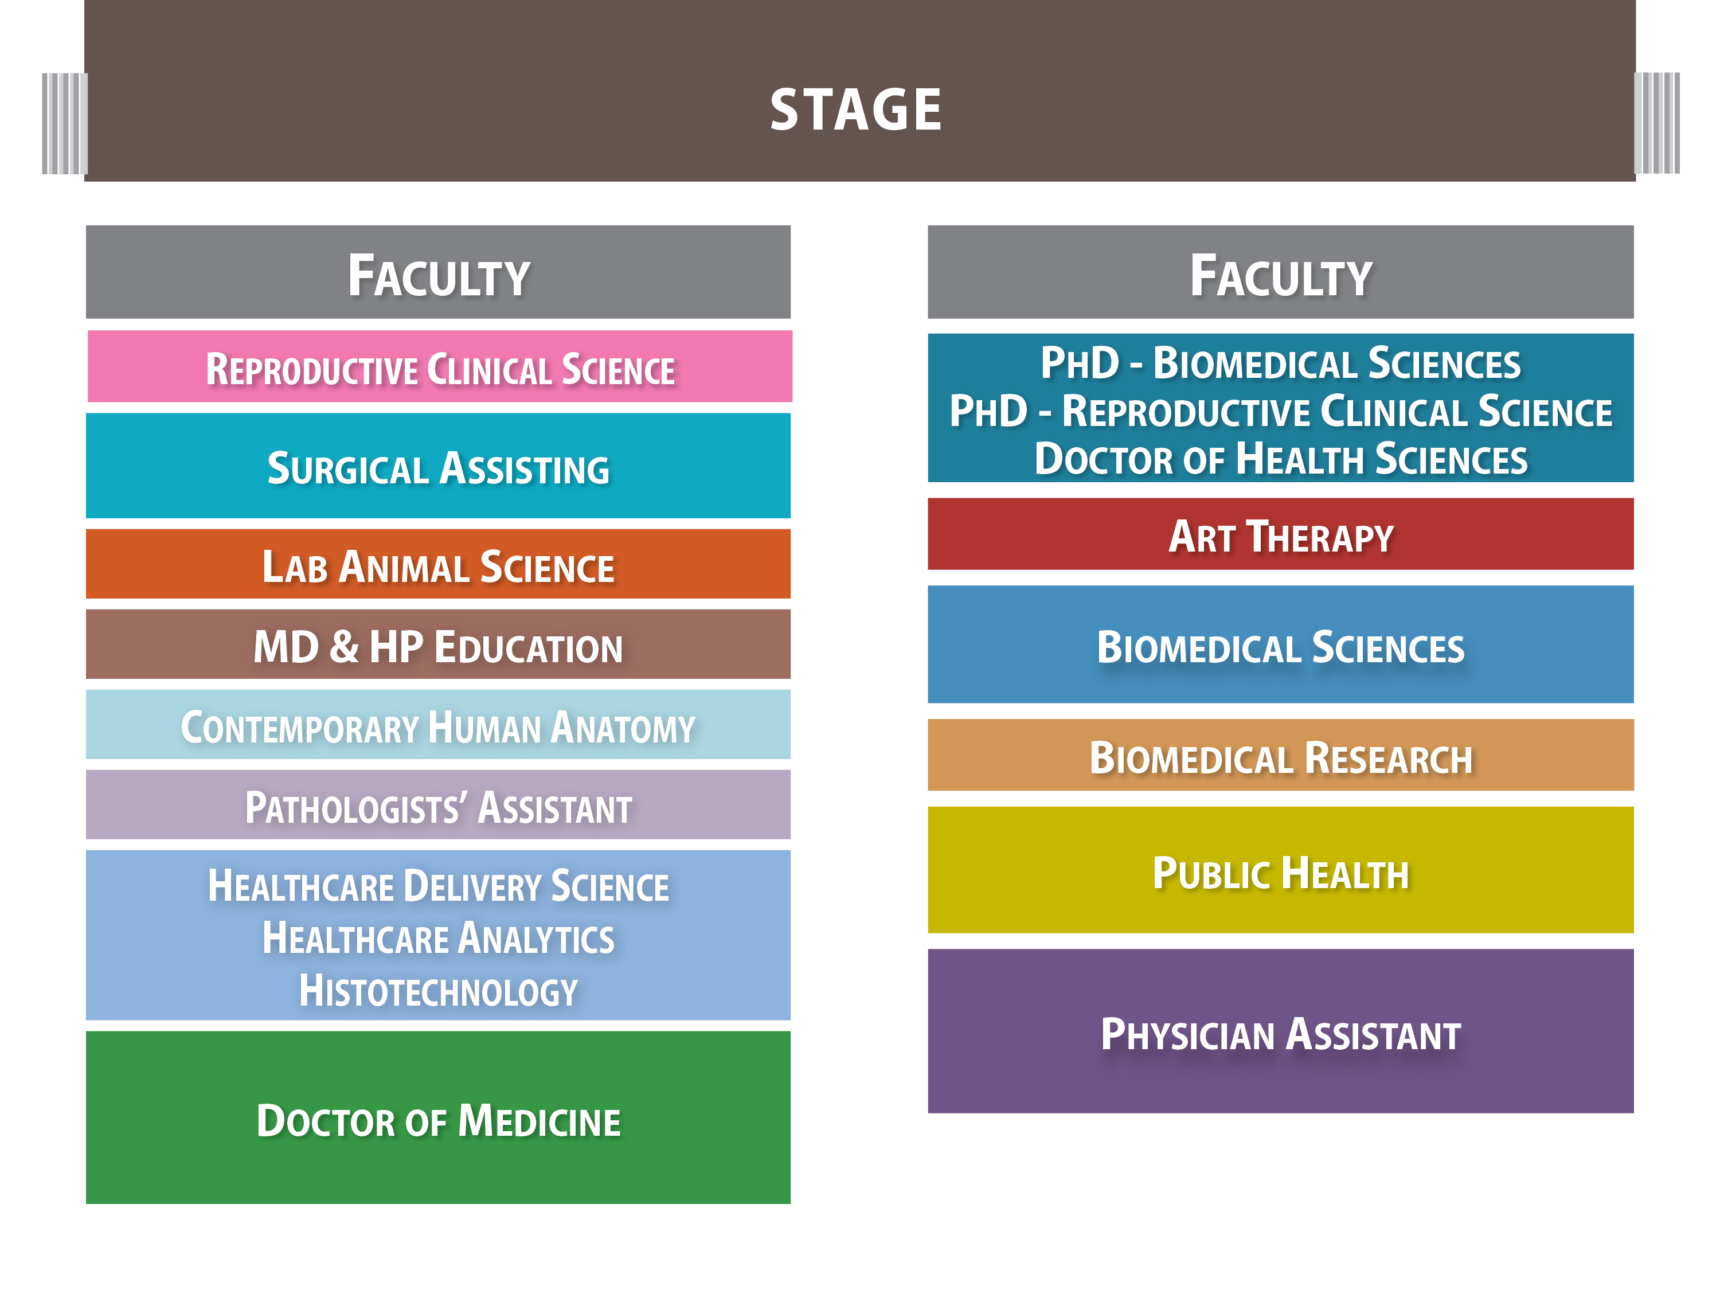
Seating Diagram
Lefts Side | Right Side
Faculty | Faculty
Reproductive Clinical Science | PhD - Biomedical Sciences
Surgical Assisting | PhD - Reproductive Clinical Science
Lab Animal Science | Doctor of Health Sciences
MD & HP Education | Art Therapy
Contemporary Human Anatomy | Biomedical Sciences
Pathologists’ Assistant | Biomedical Research
Healthcare Delivery Science Healthcare Analytics Histotechnology | Public Health
Doctor of Medicine | Physician Assistant

Slide 17
Conferral of Degrees
During the ceremony, Dr. Combs or Dr. Flenner will call for each School to stand collectively.
He will state that the academic requirements have been met.
The President will confer the degree.

Slide 18
Lining Up to Cross Stage
An usher will call your row and direct you towards the stage.
Don’t forget your reader cards.
Doctoral graduates:
Reader card in your right hand
Hood folded over your left arm – make sure it is unbuttoned.

Slide 19
Crossing the Stage
First row move to the bottom of the stairs as directed by usher.
Remaining students line up along the wall.
Following rows will remain seated until the usher directs you toward the stage.

Slide 20
Crossing the Stage
Reader card scanned before reaching the stairs.
Climb the stairs, hand the card to the reader who will read your name.
Walk as soon as you hand off your card; DO NOT WAIT for your name to be called.
Awards and distinctions (if any) will appear on the Jumbotron as you cross the stage.

Slide 21
Crossing the Stage
Take diploma cover in your left hand as you cross stage.
DO NOT SHAKE HANDS for health and safety reasons. Then descend the stairs.
Line up for individual photos alongside stage.
Ushers will direct you to return to your seat.

Slide 22
Crossing the Stage
Doctoral Graduates hooded on stage:
Ascend stairs and hand reader cards to reader.
Give hood to the hooding assistants.
Turn and face the audience.
Men, remove your caps. Women do not. Please stoop down if you are very tall.
Notes:
Men’s caps get knocked off; Women’s are typically pinned in

Slide 23
GradImages
Individual photos of graduates and returning alumni receiving diplomas and being hooded, as well as posed photos after exiting the stage, will be taken by a professional photographer.
It is important to keep the photography line running smoothly, so DO NOT STOP on the stage or stairs to pose for photos for friends or family

Slide 24
GradImages
Individual photos are available for purchase and a link will be emailed to you within 72 hours of graduation at the non-EVMS email address you provided during registration.
Photos will also be available at gradimages.com, additional photos taken by EVMS will be posted on EVMS Flickr site.

Slide 25
Confetti Wands
At the end of ceremony, the Chief Marshal will ask graduates to rise. At this time, retrieve confetti wands from under your seats.
When audience is asked to congratulate the graduates and alumni, applause and music will begin. Release confetti wands at this time – NOT BEFORE.

Slide 26
Recessional
Following, the recessional occurs in the following order:
Platform Party
Faculty
Last rows on both sides of arena floor begin first; an usher will direct you.
Move more rapidly. SPACING IS NOT IMPORTANT

Slide 27
Post Ceremony
Collect personal items stored with EVMS Police.
Class of 2022 Alumni who did not pick up their class pins/gift earlier in the week proceed to the Alumni Table.
Return any borrowed regalia items to the regalia table. Otherwise, regalia is yours to keep.
Head up to the outdoor plaza to meet your family and friends.

Slide 28
Diplomas
Diploma certificates are not in the covers you receive on stage.
2022 Graduates who have completed degree requirements will be mailed diplomas by the end of June.
Returning alumni walking in tomorrow’s ceremony should have received covers already. You may leave those received on stage in the Exhibition Hall.

Slide 29
Name Pronunciation
Linguists/Readers have reviewed the name pronunciations you provided.
You will receive your reader card at the program table.
Review your reader card once for misspellings or other inaccuracies.
At the program table they will tell if you the Linguist has requested to see you prior to the ceremony. If so, please go directly to them after you check in at program table.
Do NOT write on your reader cards.

Slide 30
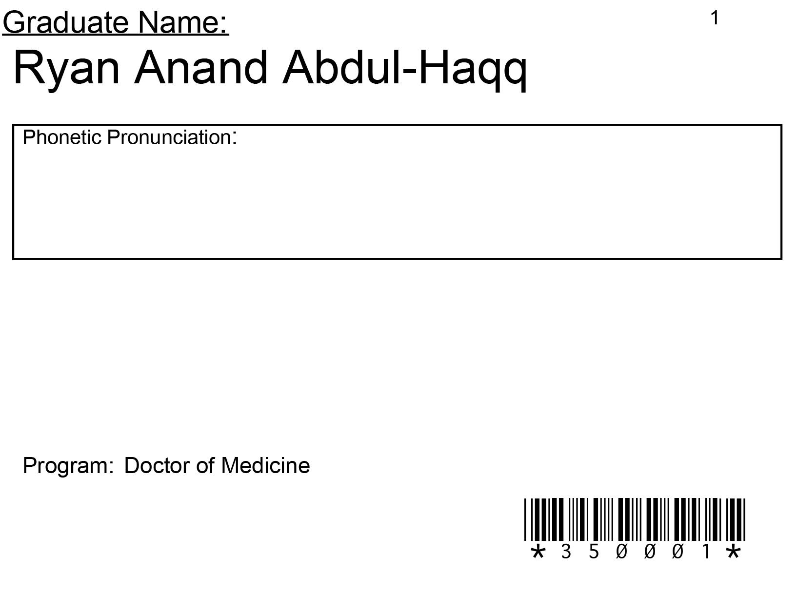
Sample Reader Card

Slide 31
Alumni Association
Stay Connected
Create your alumni profile at EVMS.EDU/ALUMNI
Attend Alumni Events
Follow Us on Facebook at Facebook.com/EVMSAlumni
Submit Class Notes
Support students following in your footsteps by volunteering

Slide 32
Alumni Association
Class of 2022, Did You Get Your Alumni Gift?
If you haven’t received your alumni gift, please visit the alumni tables near the main entrance of the Exhibition Hall on your way out.

Slide 33
Commencement App
Download the Commencement App available for both Apple and Android users.
Notifications will be sent via the app for any last minute changes.
Notes:
An email was sent with instructions to download if you haven’t already done so.

Slide 34
Reminders
DON’T BE LATE! Expect delays (travel and entry security).
DON’T FORGET YOUR REGALIA! (Tam/Mortarboard, Gown, Hood, Tassel)
Bring $5 (CASH) to pay for parking on Saturday.
Please encourage your family & friends to maintain decorum when your name is called (so that all names can be heard).
Lock valuables in your car or leave them with your family.

Slide 35
Questions?
Notes:
Please put any questions in Q&A section of BlueJeans.

Slide 36
Congratulations!

